Slide 1
NAGP
Ecommerce Case Study
“NAGP 2024-25”
Akshat Aggarwal

Slide 2




01
Understanding of Problem / Use-case
Table of contents
02
Design Considerations (NFR’s)
03
Artifacts (UML Diagram)
04
Solution Overview and Solution Diagram
05
High Level Architecture Diagram
06
Technology Stack
07
Deployment Diagram
08
Assumptions

Slide 3
Understanding of Problem/ Use-Cases

Slide 4
Problem Understanding / Use-Cases
Seamless Product Exploration
Users can browse a diverse range of products across multiple categories (e.g., Men, Women, etc.).
Search feature helps users quickly find their desired products.
2. Flexible User Authentication
New users can register using basic details and email verification.
Third-party login options (e.g., GitHub) provide a hassle-free sign-in experience.
3. Effortless Shopping Experience
Users can select products, add them to the cart, and view their selected items on the Cart Page.
If not logged in, they will be prompted to sign in before checkout.
4. Smooth Checkout & Secure Payments
Users can enter delivery details and choose from multiple payment options.
Orders are placed seamlessly, ensuring a secure and efficient transaction process.

Slide 5
Design Considerations (NFR’s)

Slide 6

NFR’s Considered for the Application
Performance & Scalability 🚀
Optimized database queries & indexing for fast response times.
Auto-scaling with AWS ECS to handle traffic surges.
Availability & Reliability ⚡
Maximum uptime using multi-AZ deployment.
Database read replicas.
Load balancer for failover & redundancy.
Security 🔒
JWT-based authentication with OAuth 2.0.
WAF & Shield for enhanced security and access control.
Maintainability 🔄
Microservices-based architecture for easy updates.
Version control with CI/CD pipelines.

Slide 7
Continuing….
5. Monitoring & Logging 📊
AWS CloudWatch, CloudTrail, and X-Ray for real-time monitoring.
6. Data Integrity 📜
ACID-compliant SQL database for transactions.
Event-driven architecture for data consistency.
7. Compatibility 🖥️
Supports major browsers (Chrome, Firefox, Edge, Safari).
Works on desktop, mobile, and tablets.

Slide 8
Artifacts (UML Diagram)

Slide 9
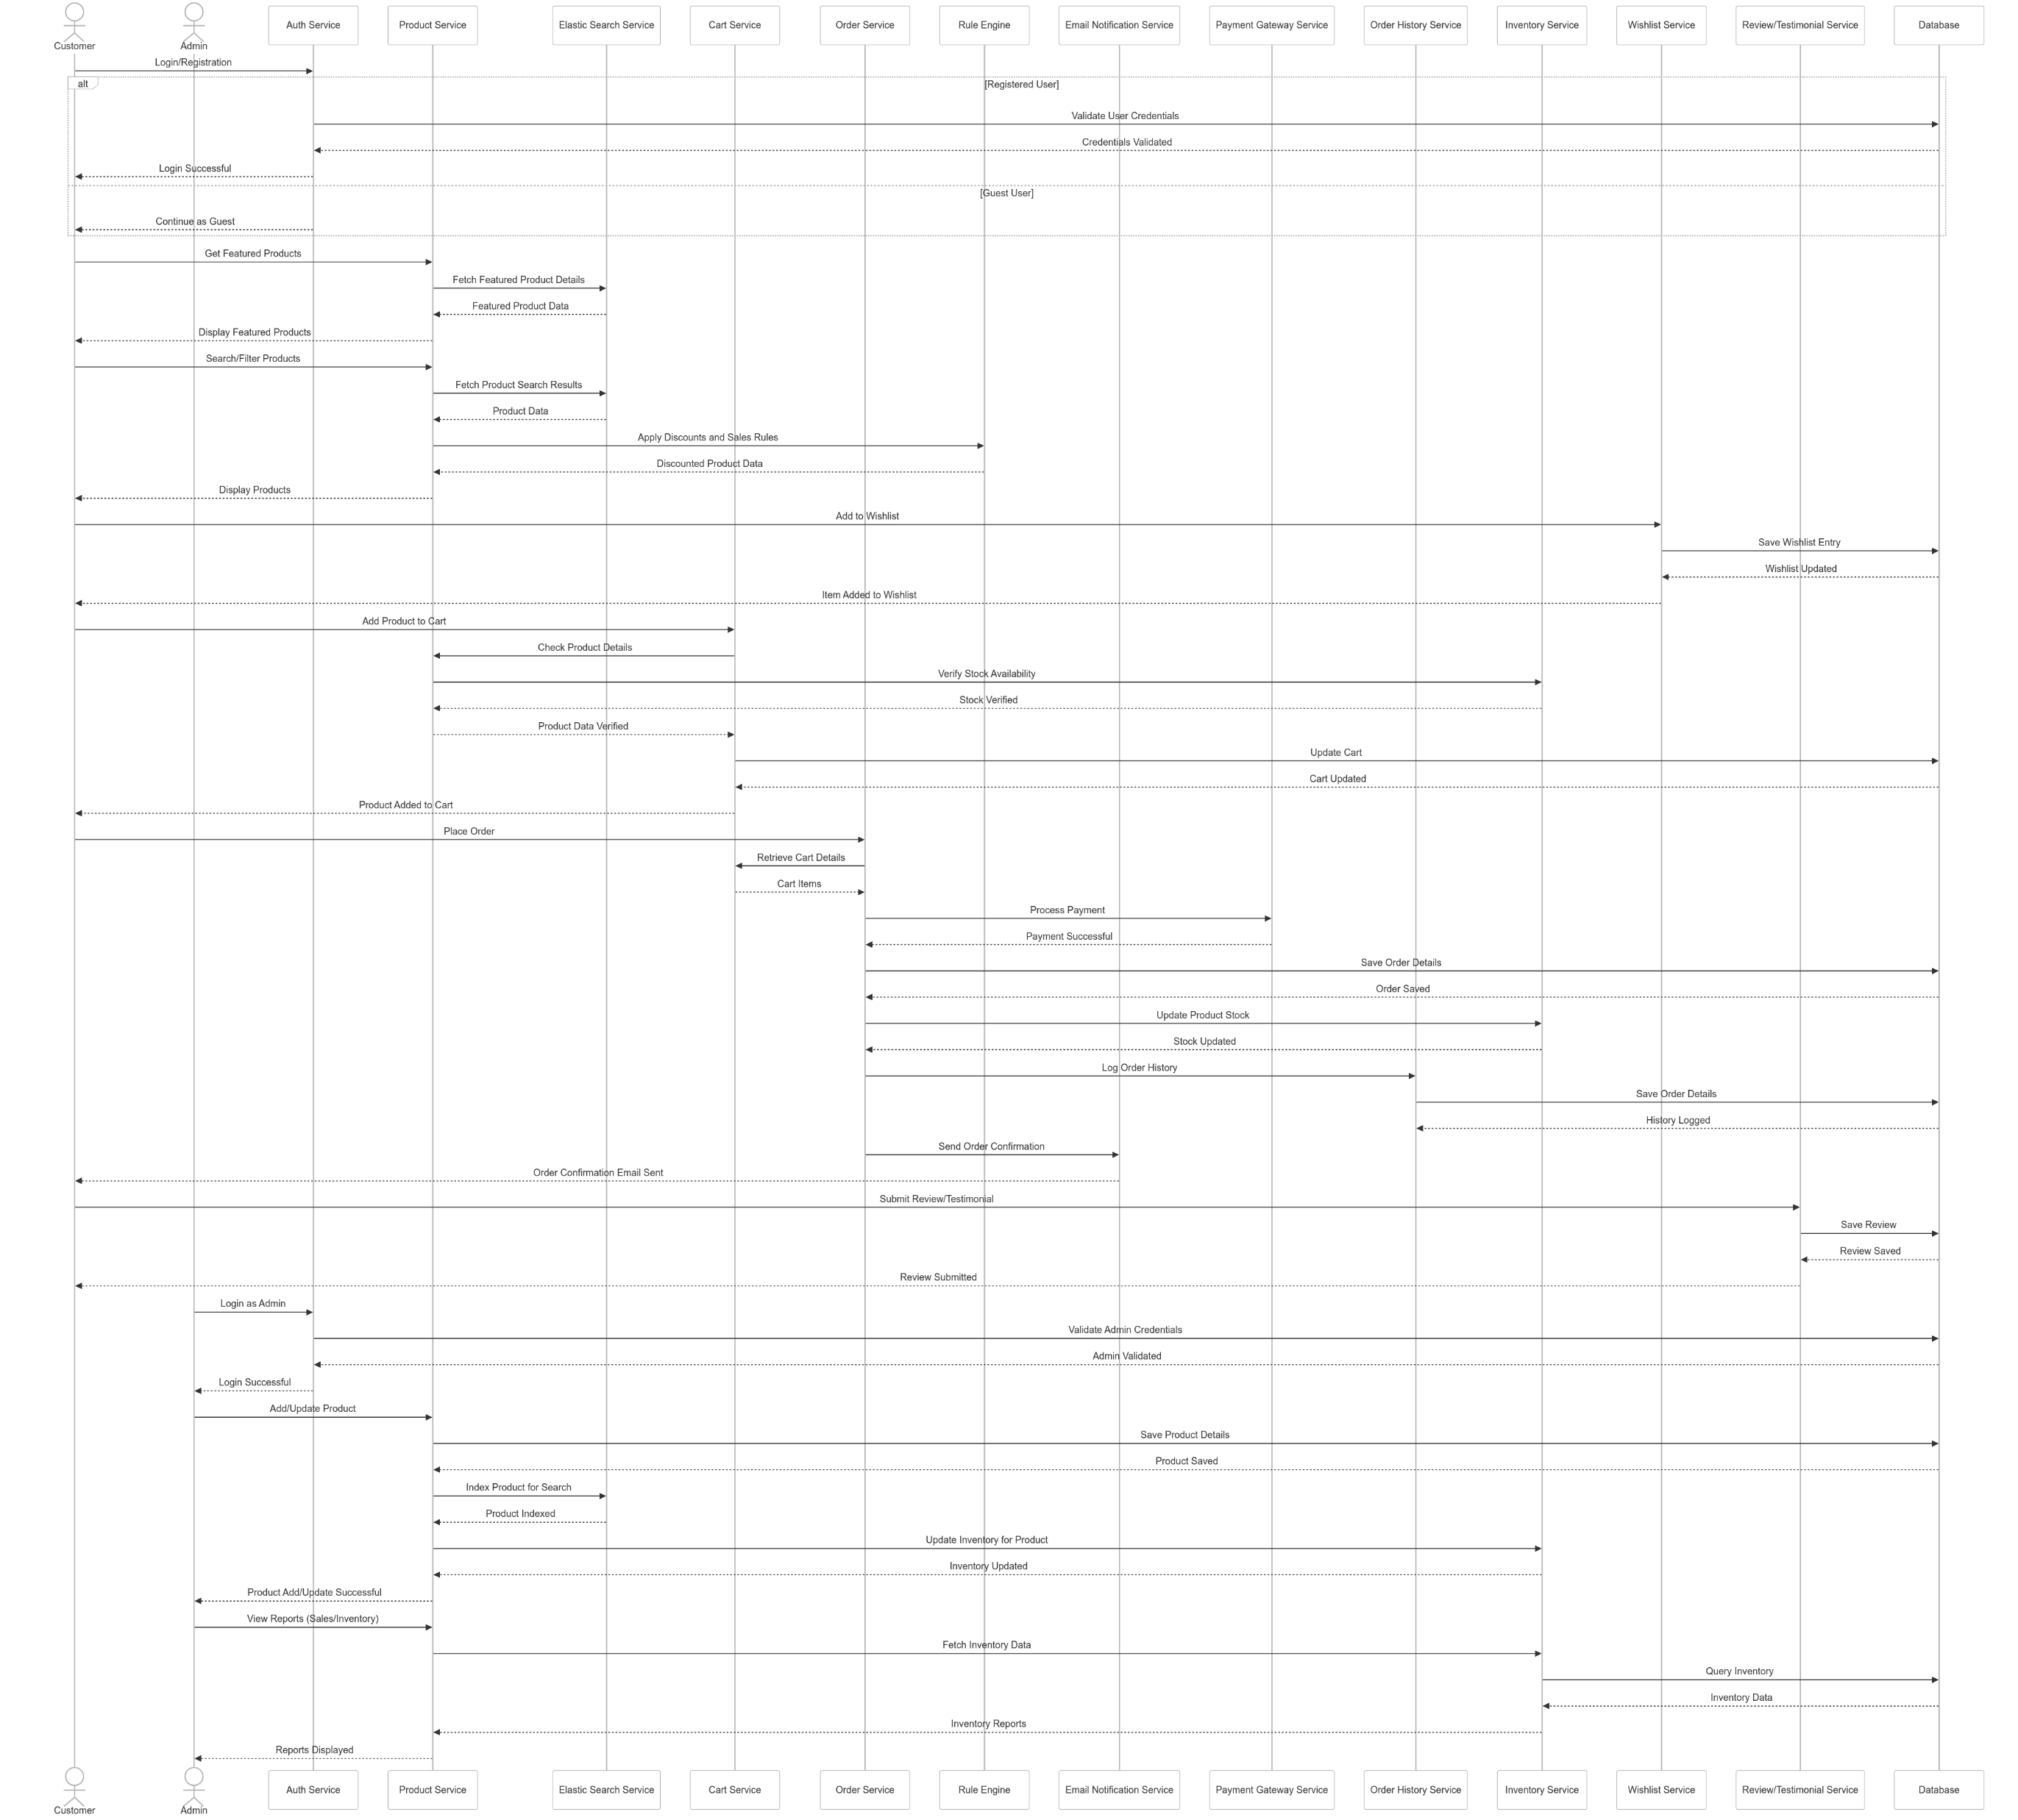
UML Diagram (Sequential Diagram)

Slide 10
Solution Overview and Solution Diagram

Slide 11
Solution Overview
Frontend
Dynamic and responsive UI with a smooth user experience using React.
Responsive Product Listing and filtering based on different filters.
OAuth-based authentication (GitHub) & Database login.
Backend – Microservices
Product, Cart, Order, Inventory, Wishlist, Review, Search Service etc.
Drool’s Rule Engine for managing dynamic pricing and discounts.
Kafka-based event-driven architecture for smooth inter-service communication.
Database & Storage
MySQL for structured data like orders & user details.
Mongo DB - NoSQL for products data, reviews.
Redis Cache for faster response times.
S3 Bucket for storing images and static content.

Slide 12
Continuing.…
AWS-based Deployment
AWS ECS with Fargate for scalable containerized microservices.
API Gateway with authentication & rate limiting.
CloudFront CDN for faster content delivery.
AWS SNS & SES for email & push notifications.
Observability & Security
CloudWatch, CloudTrail & AWS X-Ray for monitoring and debugging.
WAF & Shield for enhanced security and access control.
Automated Backups & Disaster Recovery for business continuity.

Slide 13
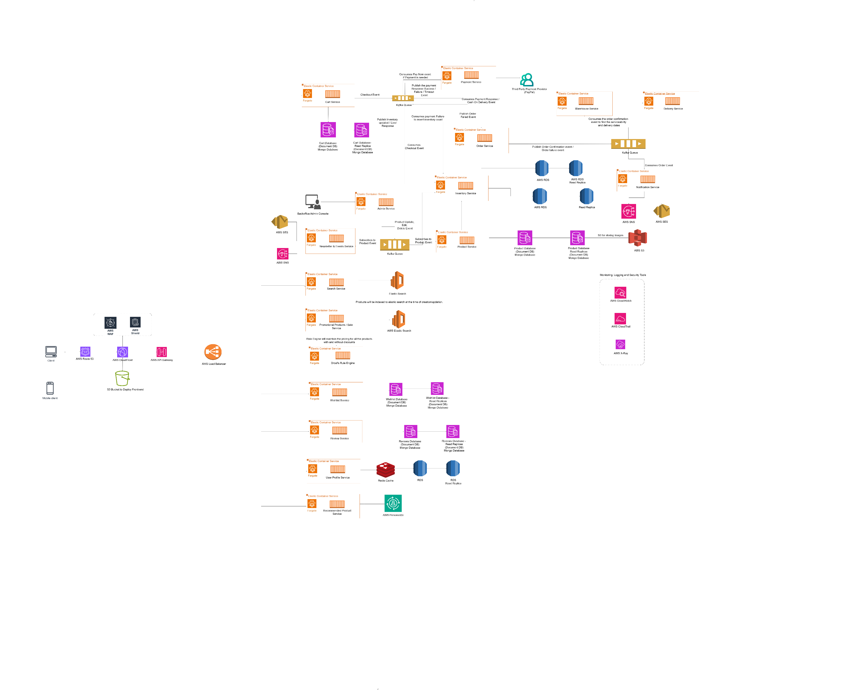
Solution Diagram

Slide 14
High Level Architecture Diagram

Slide 15
High Level Architecture Diagram

Slide 16
Technology Stack

Slide 17
Technology Stack
Frontend – React
Backend – Java, Spring Boot
Image storage – S3 Bucket
Caching – Redis Cache
Events Queue – Kafka
Search Engine – Elastic Search
Databases – SQL and NO-SQL
Logging and Monitoring – AWS CloudTrail, AWS CloudWatch, AWS X-Ray
Notification - AWS SNS, AWS SES
CDN – AWS CloudFront

Slide 18
Deployment Diagram

Slide 19
Deployment Diagram

Slide 20
Assumptions

Slide 21
Assumptions
Predefined Product Pricing
All products will have their base prices stored in the product database.
Dynamic Discount Calculation
When a user searches for a product or visits a promotional section, the Rule Engine will dynamically determine the applicable discount.
Real-Time Discounted Pricing
The Rule Engine generates a new field for the discounted price, which will be displayed on the UI in real-time.

Slide 22
Thank You

Slide 23
Continuing.…
Design Consideration | Implementation in AmCart
Portability 🌍 | Dockerized services, Kubernetes (EKS) support, React Frontend compatible across devices.
Monitoring & Logging 📊 | AWS CloudWatch, CloudTrail, X-Ray, ELK Stack for log aggregation, proactive alerts.
Data Integrity 📜 | SQL (MySQL) for transactions, NoSQL (DynamoDB, Elasticsearch) for unstructured data.
Regulatory Compliance ✅ | GDPR-compliant user data storage, AWS Audit logs, PCI-DSS-ready payment integration.

Slide 24
Solution Overview
Design Consideration | Implementation in AmCart
Scalability & Performance 🚀 | AWS ECS with Fargate for containerized deployment, Elastic Load Balancer for traffic distribution, Redis caching for quick response times.
Availability & Reliability ⚡ | Multi-AZ RDS & NoSQL Mongo DB, Auto Scaling groups, API Gateway for managing traffic spikes.
Security 🔒 | OAuth2.0, JWT Authentication, AWS WAF for protection, IAM Role-based access.
Maintainability 🔄 | Microservices architecture, CI/CD pipelines using GitHub Actions, modular services for easy updates.

Slide 25
Application Use Cases
The Amcart Ecommerce Application should allow user to browse through different types of products.
User can register in the Amcart Ecommerce Application using their basic details and email id.
User can also login via third party authentication like GitHub and proceed further.
User can see different categories of products on the application UI like Men, women etc.
User can also search products using the search box at the top of the application UI to get the exact products they are looking for.
Once user selects any product and they can Add to cart, user can proceed to cart page to see the product selected.
If the user is not logged in at the time of checkout, they will be asked to login first.
Once user proceed to checkout, user can add their delivery details and select the payment mode.
After that, user can proceed to place order.

Slide 26
Solution Overview
The Request will start from the user opening the ecommerce application.
The Request will go to the DNS which will redirect the web address to the IP of our application.
The frontend will be hosted on the S3 bucket with all the static content like images and videos will be cached in CDN.
The request will pass through the API Gateway, which will act as the single point of entry into the application.
There will also be a load balancer, which will balance the load among different instances of services.
I have followed the microservices architecture, where in each service will have there own databases attached with itself.
To Store images for all the products, I have made use of AWS S3 Bucket.

Slide 27
Continuing.…
For the Search functionality, there will be elastic search which will act as the search engine to provide faster search responses on the site.
To send out different kinds of communication, I am using AWS SNS and AWS SES.
There will be a promotion service, which will link with the Drool’s rule engine. The rule engine will provide the discounted price if any for all the products.
To login there will be two options available to the user i.e., by registering in the application and by signing in using GitHub.
To provide recommendation to the user based on their activity on the site, I have made use of AWS Personalize.
The Payment Service will integrate with third party payment provider like PayPal etc.
For Monitoring and Logging, I have made use of AWS CloudWatch, AWS CloudTrail and AWS X-Ray

Slide 28
Assumptions
keeping the initial prices of all the products in the product database.
When the user searches for any product or go to any page for products with promotions then we will use rule engine to calculate the applicable discount on the original price for the product.
The Rule engine will create a new field which will be discounted price, and we will display that.

